Slide 1
Zero Tolerance The Role We All Play to Prevent Abuse
PRESENTED BY
Christy Smiley, Kari Anderson & Janette Canas, Zero Tolerance Liaison's
Ron DeSantis, Governor
Taylor Hatch, Director

Slide 2
The Agency’s Mission​
The Agency supports individuals with unique abilities and their families in living, learning and working within their communities by creating multiple pathways to possibilities. ​

Slide 3
TOPICS TO DISCUSS
Today’s Agenda
About our Agency
Florida Statutes
Abuse, Neglect, and Exploitation
National Statistics
Bullying
Prevention Methods
Reporting and Barriers

Slide 4
Zero Tolerance Initiative
APD’s Zero Tolerance Initiative was created as a community effort to combat abuse, neglect, and exploitation against persons with intellectual and developmental disabilities.
While APD has made significant progress in our prevention efforts, much work remains to be done.
We want to help empower you to break down the wall of silence and report, report, report.

Slide 5
Know the Laws
415.101: Adult Protective Services Act
39.001: Proceedings Relating to Children
It is the intent of the Legislature to provide for the detection and correction of abuse, neglect, and exploitation through social services and criminal investigations and to establish a program of protective services for all vulnerable adults.
To provide the care, safety, and protection of children in an environment that fosters healthy social, emotional, intellectual, and physical development; ensure secure and safe custody; to promote the health and well-being of all children under the state’s care; and to prevent the occurrence of child abuse, neglect, and abandonment.

Slide 6
People with disabilities are more likely to experience
Abuse, neglect, exploitation, and sexual misconduct, which is more severe and can last for longer periods of time
Multiple and repeat perpetrators
Abuse more frequently than others
Difficulty escaping abusive situations
Inadequate or inappropriate health care
Finding justice or services
Source: Intervention Tips. I-CAN! Accessibility Project Virginia Commonwealth University School of Social Work and Partnership for People with Disabilities . Retrieved from Slide Serve: https://www.slideserve.com/pmello/people-with-disabilities-affected-by-violence-court-advocacy-and-intervention-tips-powerpoint-ppt-presentation

Slide 7
ABUSE IS…
Any willful act or threatened act by a relative, caregiver, or household member which causes or is likely to cause significant impairment to an individual’s physical, mental, or emotional health. Abuse includes acts and omissions.

Slide 8
Signs of Abuse
Inappropriate or unwanted touching of sexual parts
Pushing, Hitting
Mistreating service animals (9.208(3), F.S.)
Mistreating Service Animals
Withholding food or medications
Taunting, emotional stress
Burns, Bruises
Injuries in Unlikely Places
Sudden Difficulty Walking or Sitting
Notes:
Poor or Improper, Hygiene Dehydration, Broken Bones, Sprains, Fractures

Slide 9
NEGLECT IS…
The failure or omission on the part of the caregiver to provide the care, supervision, and services necessary to maintain the physical and mental health of the individual such as food, clothing, medicine, shelter, supervision, and medical services, which a prudent person would consider essential for their safety and well-being.

Slide 10
Signs of Neglect
Leaving individuals unattended with no way to call for help
Leaving individuals in bed all day
Leaving individuals in soiled diapers
Self-neglect (Call 850-300-HOPE for assistance)

Slide 11
EXPLOITATION IS….
A person who stands in a position of trust and confidence with a vulnerable individual and knowingly, by deception or intimidation, obtains or uses, or endeavors to obtain or use, the person’s funds, assets, or property with the intent to temporarily or permanently deprive a individual of the use, benefit, or possession of the funds, assets, or property for the benefit of someone other than the individual.

Slide 12
Signs of Financial Exploitation
Sudden decrease or change in bank account balances
Sudden problem paying bills or buying food or other necessities
Sudden changes in wills or other financial documents

Slide 13
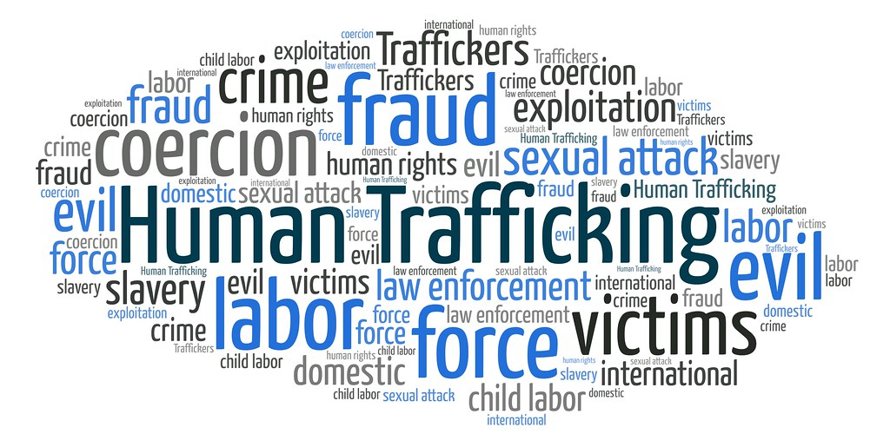
Human Trafficking
Transportation, soliciting, recruiting, harboring, providing, enticing, maintaining, or obtaining another person for the purpose of exploitation of that person.
Florida Statute Chapter 787.06(2)(d)

Slide 14
Types of Human Trafficking
LABOR: Agriculture, Begging, Tourism, Nail Salon, Factory Labor
SEX: Prostitution, Brothels, Clubs, Massage Parlors, Escort Services
LABOR: Agriculture, Begging, Tourism, Nail Salon, Factory Labor
DOMESTIC SERVITUDE: Nanny, Live-in Maid, Cook, Landscaper, Butler

Slide 15
Some individuals with developmental disabilities are more likely to be victimized because of the perception of a social stigma, inability to assess danger until it is at crisis level, and lack of education. A few examples are….

Slide 16
Risk Factors
Unable to report the crime
Not considered credible reporters
May be socially isolated
Lack of economic independence
Dependence on others for long-term care
Unable to differentiate between appropriate and inappropriate touching
Lack of participation in abuse awareness and personal safety programs

Slide 17
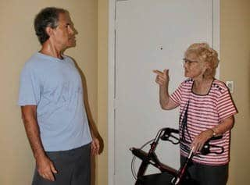
Potential indicators of Caregiver abuse Indicators
Refusing to follow directions or complete necessary personal tasks for dependent person
Using vehicle, money, or other resources without consent
Using threats or menacing looks/body language as a form of intimidation
Speaking for the person with developmental disabilities for attention

Slide 18
Caregiver Risk Factors
Caregiver stress and burnout can be a risk factor for abuse
Caregiver may be experiencing their own personal trauma
Focus on what you can do
Set Goals you can reach
Ask for and accept help
Make a list of ways in which others can help you
Source: Relias LLC, 2023

Slide 19
Abuse Indicators
The single most important thing to indicate the possibility of abuse, neglect, or exploitation of a person with a developmental disability is CHANGE.

Slide 20
THERE IS NO UNIVERSAL RESPONSE TO ABUSE, NEGLECT, OR EXPLOITATION. EVERY INDIVIDUAL RESPONDS DIFFERENTLY AND, IN SOME CASES, THERE MAY BE NO OUTWARD SIGNS AT ALL.

Slide 21
Your response to a victim should always communicate…
I believe you.
It’s not your fault.
You are not alone.
I want to help you.

Slide 22
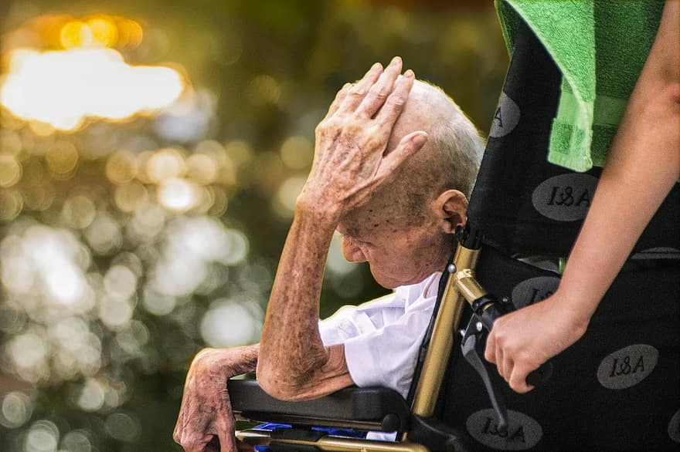
According to National Statistics report the rate of violent victimization against persons with disabilities was at least 3.5 times the rate against those without disabilities (per 1000 people surveyed from ages 12 and older).
Approximately 33% percent of the victims of violent crimes, knew their perpetrators.
Source: Bureau of Justice Statistics, National Crime Victimization Survey, 2009-2019. Published November 2021 by NCJ 301367

Slide 23
TITLE
Children with disabilities, such as physical, developmental, intellectual, emotional, or sensory, are at an increased risk of being bullied.
Source: www.stopbullying.org

Slide 24
Cyberbullying
Occurs on Social media platforms, such as Facebook, Instagram, snapchat, and Twitter
Instant Message
Text Message
Email

Slide 25
Prevention Methods
Research shows the single most effective way to prevent abuse, neglect, exploitation, and sexual misconduct is by providing education and self-protection training directly to individuals with disabilities.

Slide 26
Prevention of Abuse, Neglect, Exploitation, and Sexual Abuse of Individuals with Disabilities

Slide 28
How Do I Report Abuse, Neglect, and Exploitation?
Telephone:
1-800-6-ABUSE (2873)
Fax:
1-800-914-0004
Telephone Device for Deaf (TDD):
1-800-955-8771
Florida Relay: 711
For additional assistance not related to abuse call:
1-850-300-Hope (4673)
Online: http://www.dcf.state.fl.us/programs/abuse/

Slide 29
For additional literature and educational trainings, please visit the APD Zero Tolerance website at apd.myflorida.com/zero-tolerance

Slide 30
For additional questions or concerns, please contact us or visit the APD booth
Christy Smiley
Christy.Smiley@apdcares.org
850-445-4317
Janette Canas
Janette.Canas@apdcares.org
850-414-8606
Kari Anderson
Kari.Anderson@apdcares.org
850-922-4204

Slide 31
Thank You
Agency for Person’s with Disabilities:
Zero Tolerance Initiative
Zero Tolerance | APD - Agency for Persons with Disabilities - State of Florida (myflorida.com)

